Slide 1
QUTIP Simulation
Sangyeon Lee
Seoul National Univ.
QDL (Quantum Device LAB. at SNU)
Prof. Eunjong Kim
Date: 2023.12.26

Slide 2
Contents
Resonator Drive Pulse
TI Qubit-Resonator Hamiltonian (Quantum Rabi)
https://github.com/BrainConnection/QuTiP

Slide 3
Resonator Drive Pulse

Slide 4
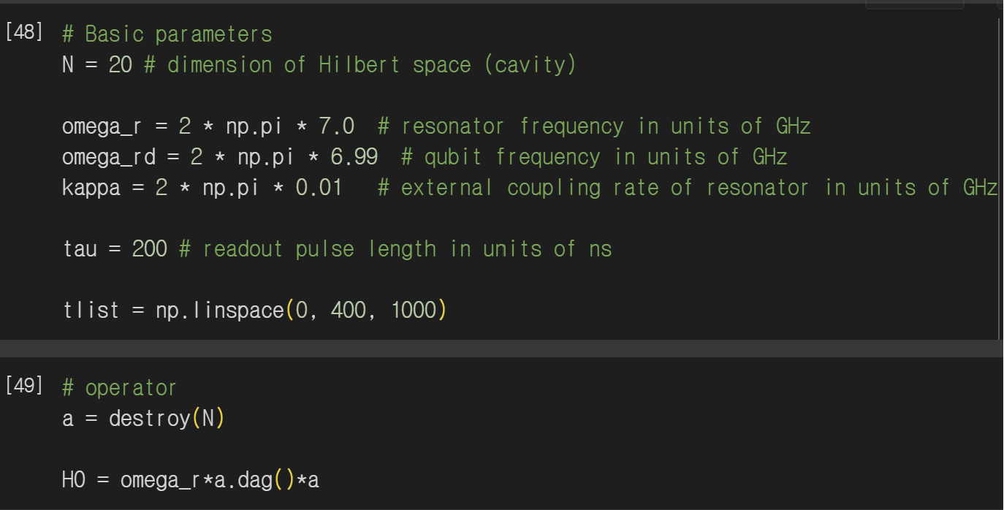

Resonator Drive Pulse
Resonator + Drive Pulse Hamiltonian, Not coupled with Qubit yet
$H_{R}=ω_{r}a^{†}a+A_{0}(a+a^{†})\cos{ω_{rd}t}$
Rotating frame, $ω_{rd}$
$\tilde{H_{R}}=(ω_{r}−ω_{rd})a^{†}a+A_{0}\frac{a+a^{†}}{2}$
Evolution of Annihilation Operator
$\dot{a}=\left[−i\left(ω_{r}−ω_{rd}\right)−\frac{γ}{2}\right]a−\frac{i}{2}A_{0}$

Slide 5
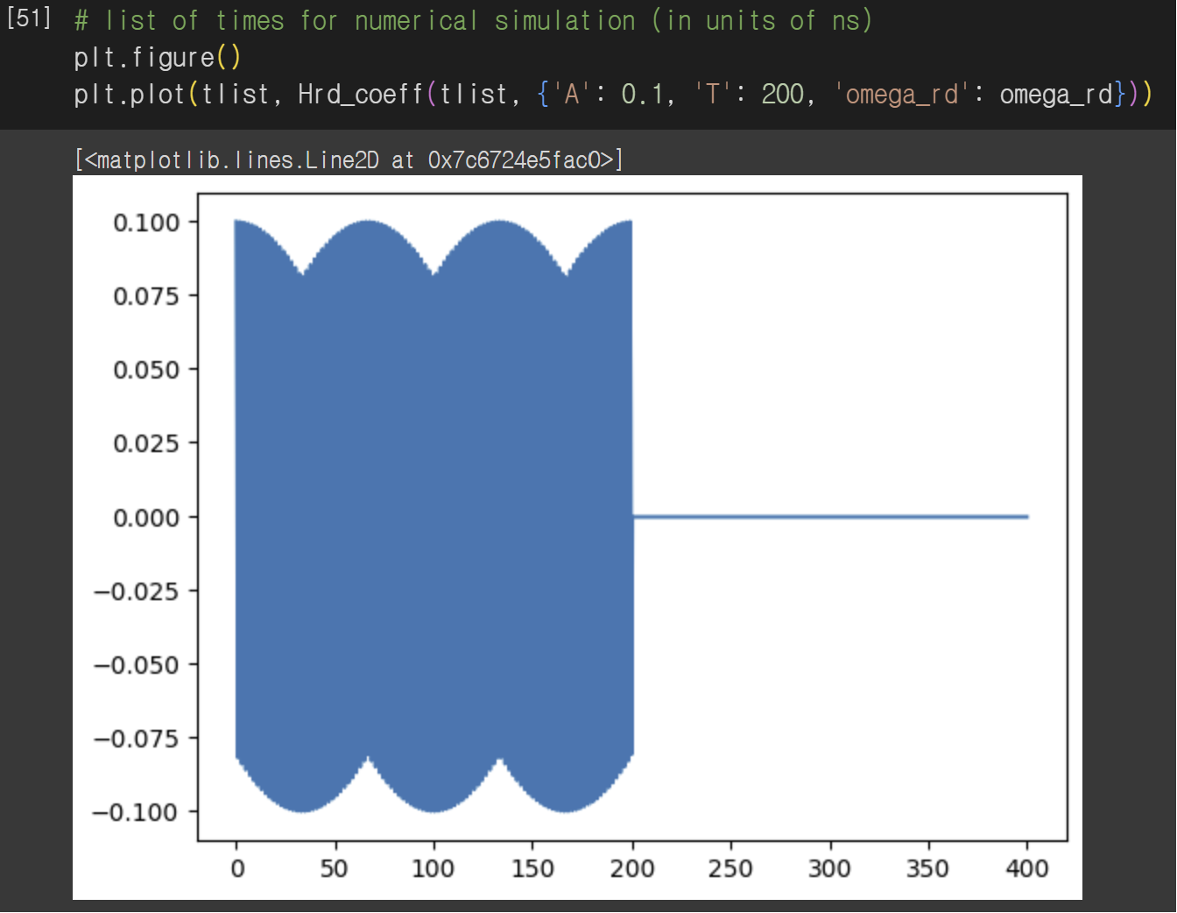
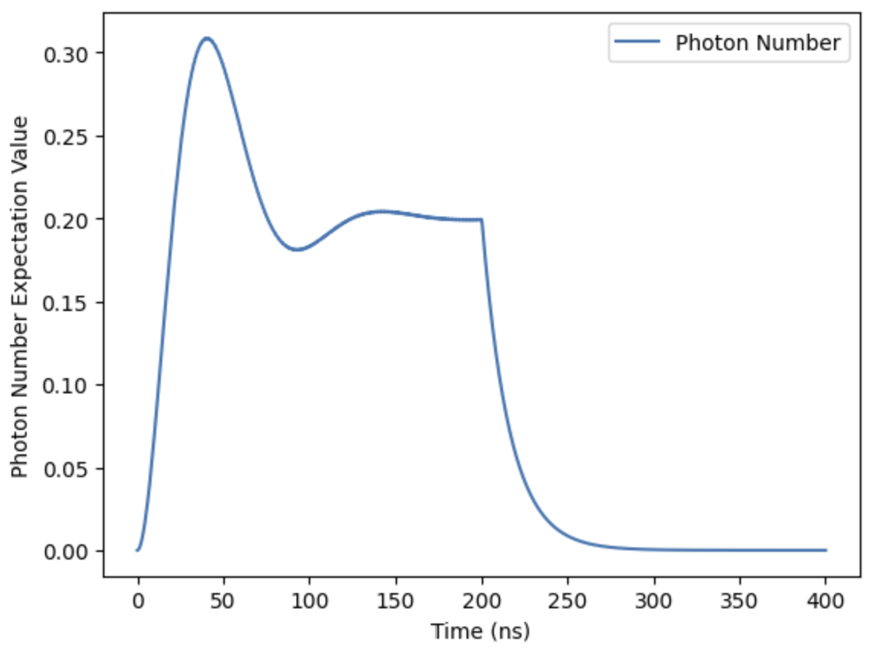
Resonator Drive Pulse
Square Pulse

Slide 6

Resonator Drive Pulse
$\dot{a}=\left[−i\left(ω_{r}−ω_{rd}\right)−\frac{γ}{2}\right]a−\frac{i}{2}A_{0}$
$a\left(t\right)=−\frac{\frac{i}{2}A_{0}}{i\left(ω_{r}−ω_{rd}\right)+\frac{γ}{2}}+\left[a\left(0\right)+\frac{\frac{i}{2}A_{0}}{i\left(ω_{r}−ω_{rd}\right)+\frac{γ}{2}}\right]e^{\left[−i\left(ω_{r}−ω_{rd}\right)−\frac{γ}{2}\right]t}$
Let initial photon number zero
$\left\langle n\right\rangle =\left\langle a^{†}a\right\rangle =\frac{{\left(\frac{A_{0}}{2}\right)}^{2}}{{\left(ω_{r}−ω_{rd}\right)}^{2}+{\left(\frac{γ}{2}\right)}^{2}}\left[1−2e^{−\frac{γ}{2}t}\cos\left(ω_{r}−ω_{rd}\right)t+e^{−γt}\right]$
Steady State
$n_{s}=\frac{{\left(\frac{A_{0}}{2}\right)}^{2}}{{\left(ω_{r}−ω_{rd}\right)}^{2}+{\left(\frac{γ}{2}\right)}^{2}}$
After steady state, driving off
$\left\langle n\right\rangle =n_{s}e^{−γt}$

Slide 7
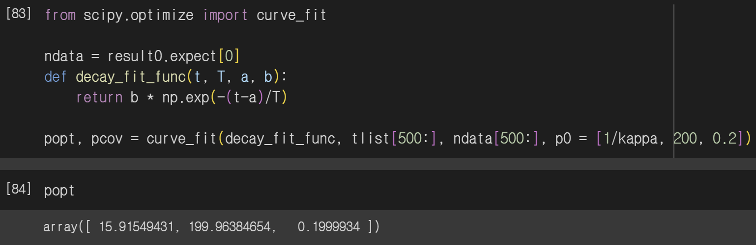
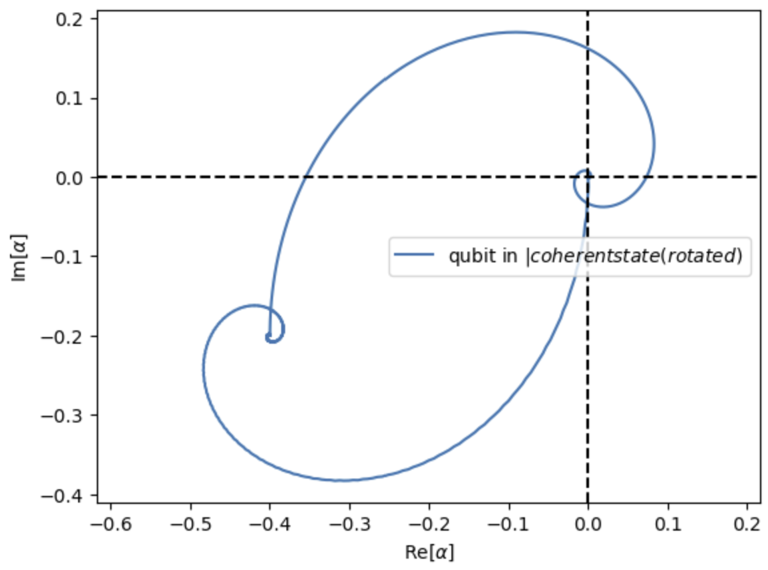
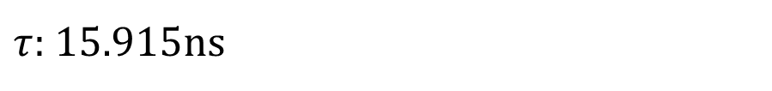
Resonator Drive Pulse
$τ$: 15.915ns

Slide 8
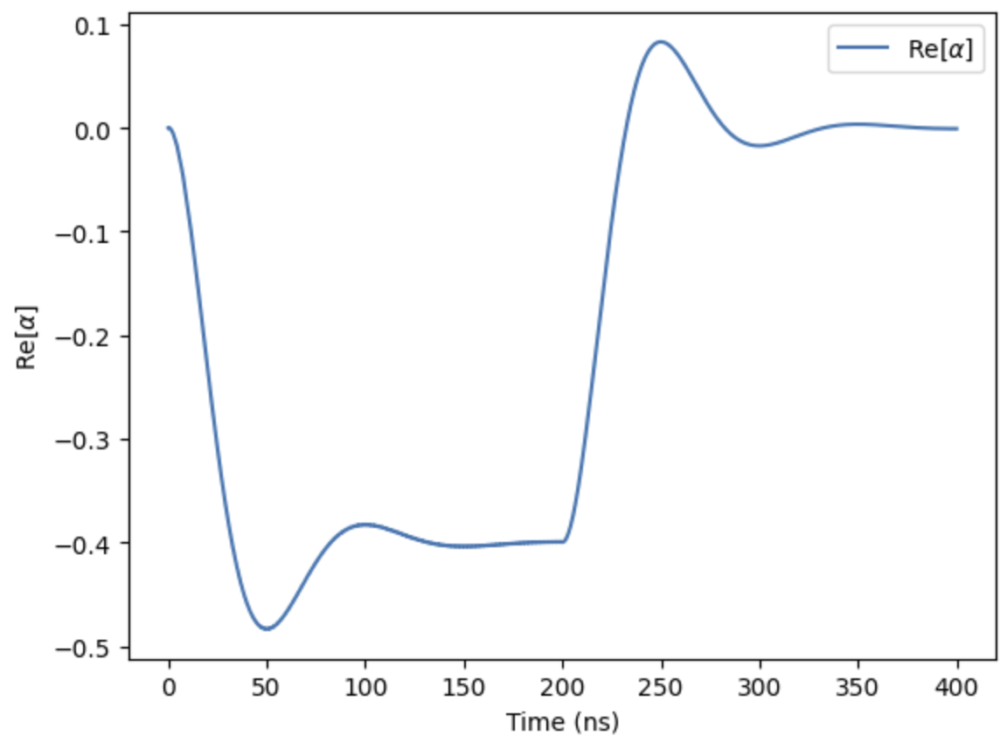
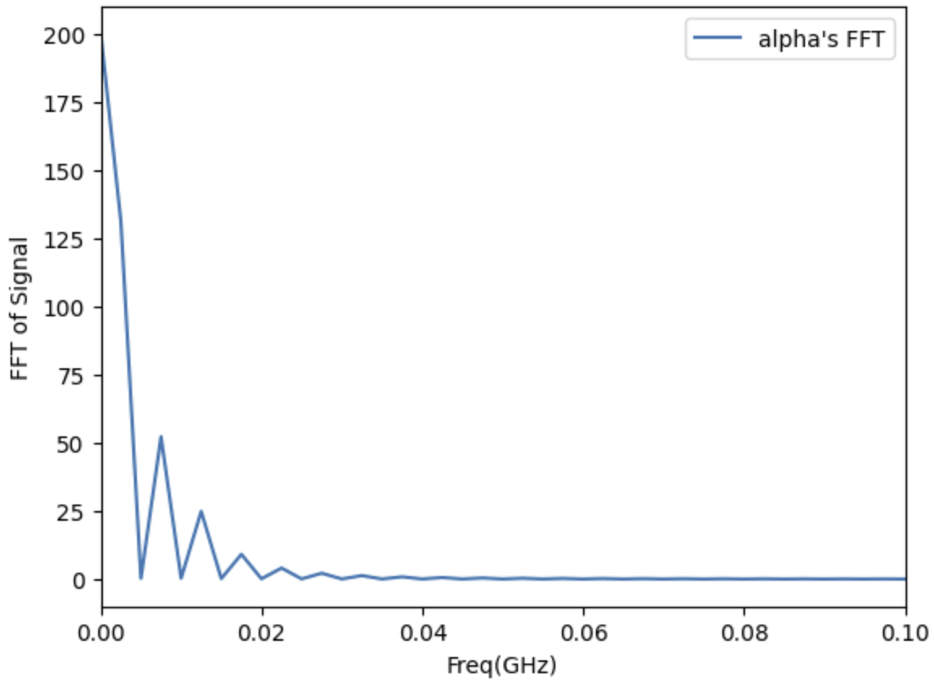
Resonator Drive Pulse

Slide 9
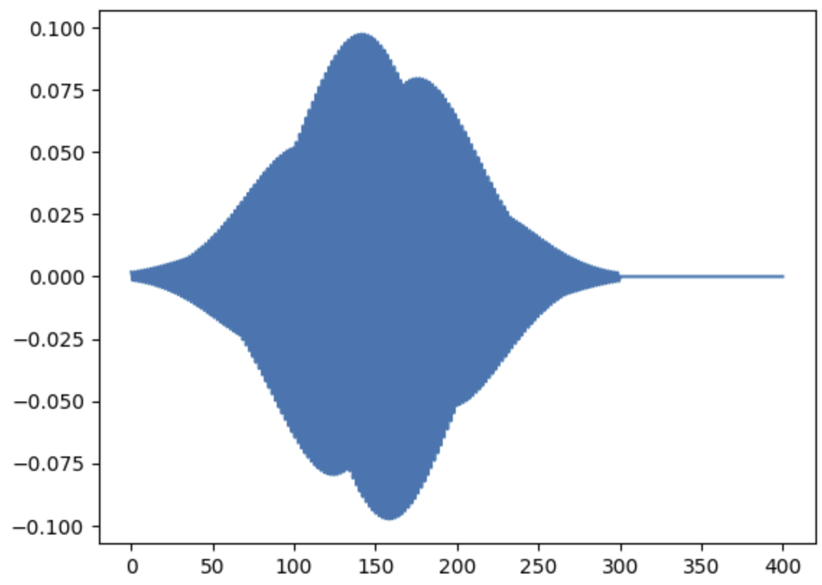
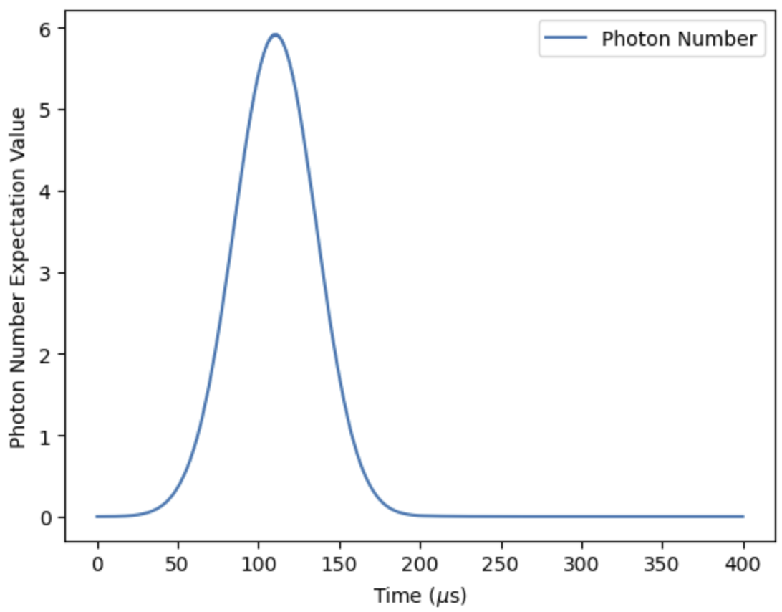
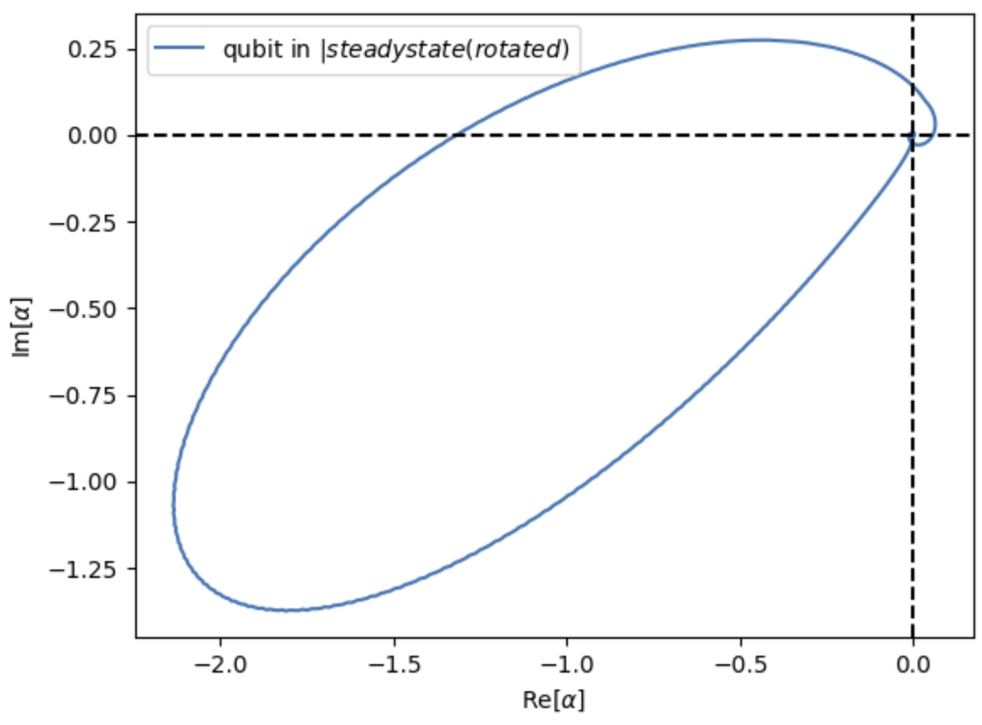
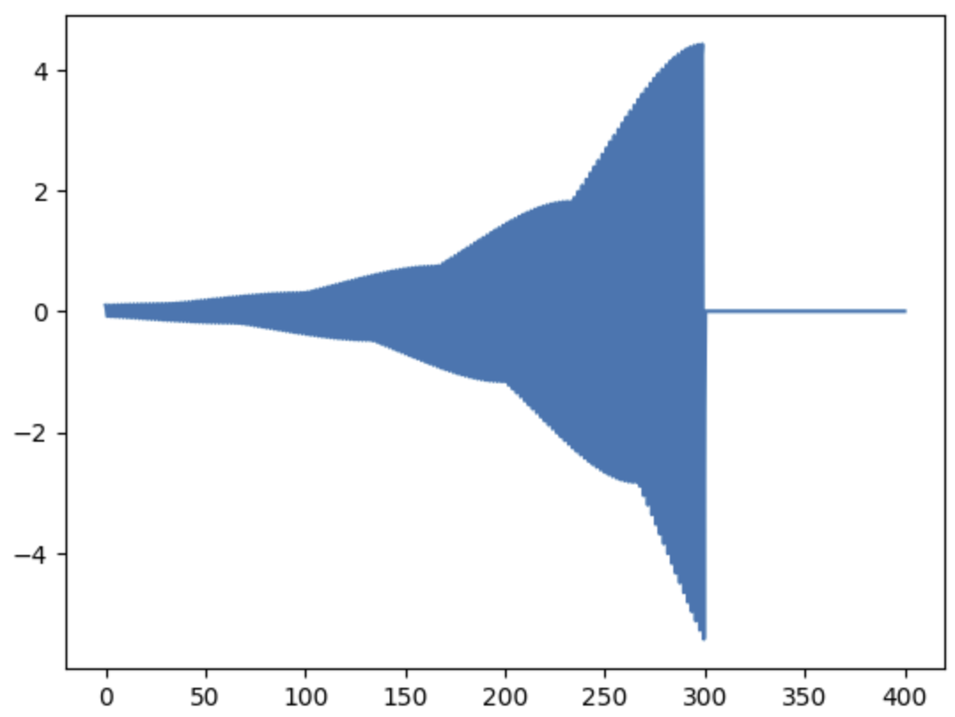
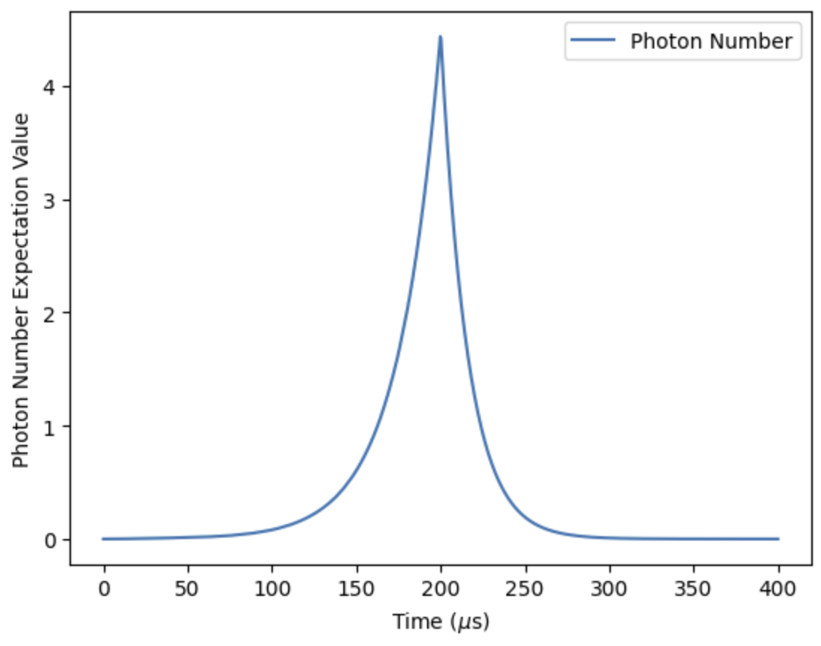
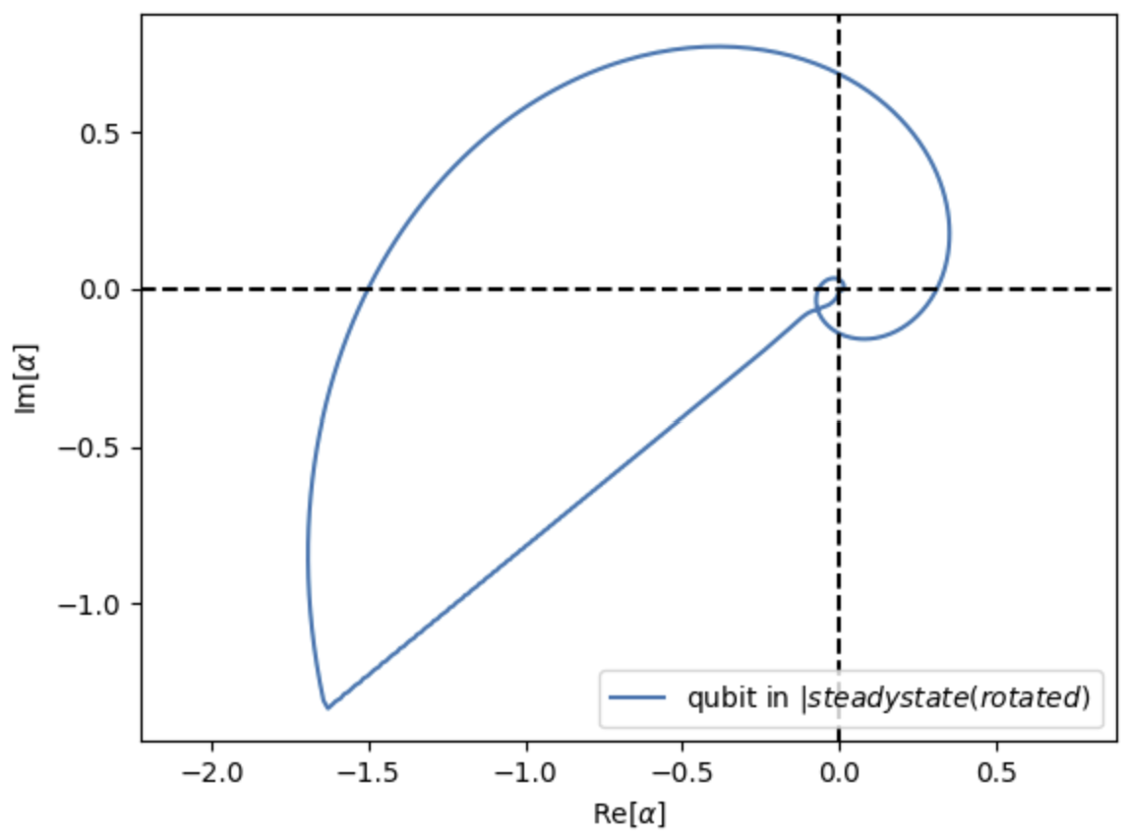
Resonator Drive Pulse
Gaussian Pulse
Exponential Pulse

Slide 10
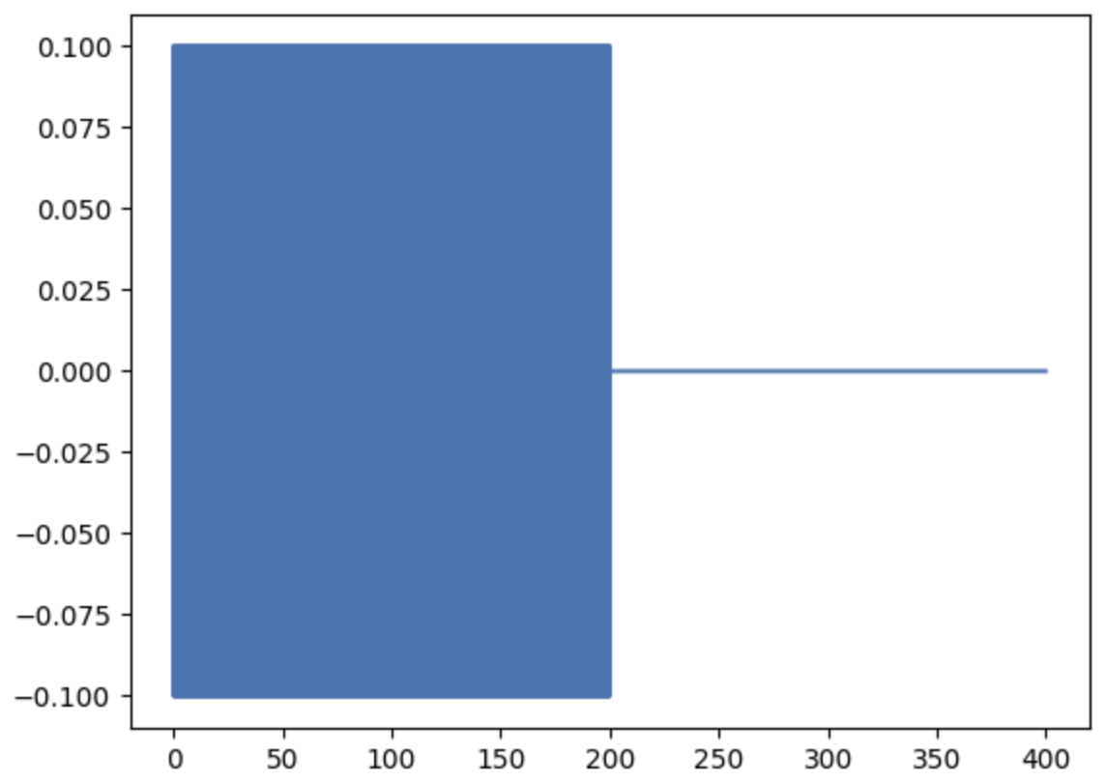
Resonator Drive Pulse
Why Square Pulse?
Why not Gaussian, Exponential, Sinusoidal… etc?
Photon Number?
Fidelity?
Readout Signal/Time?
How about Bandwidth?

Slide 11
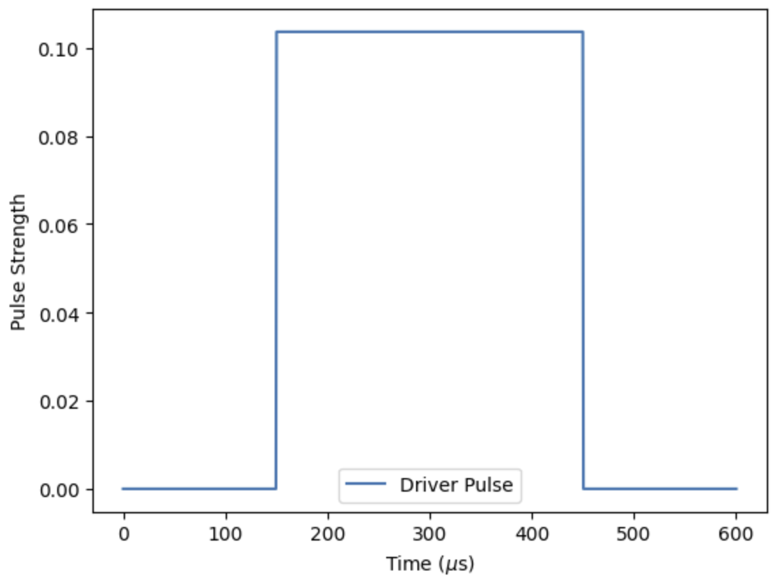
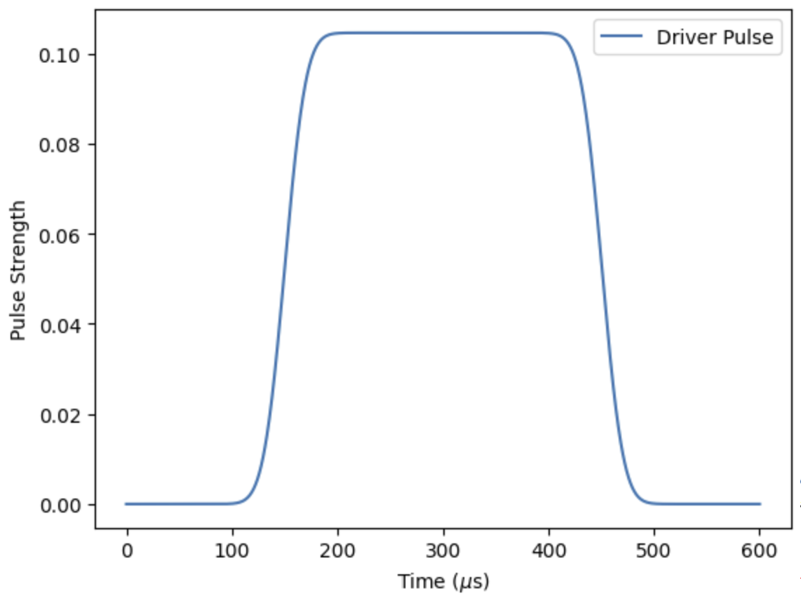
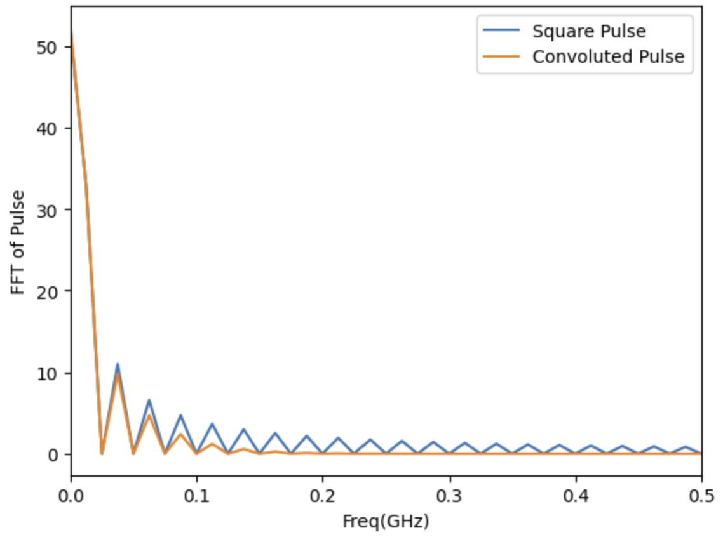
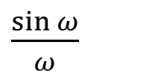
Resonator Drive Pulse
$\frac{\sin{ω}}{ω}$

Slide 12
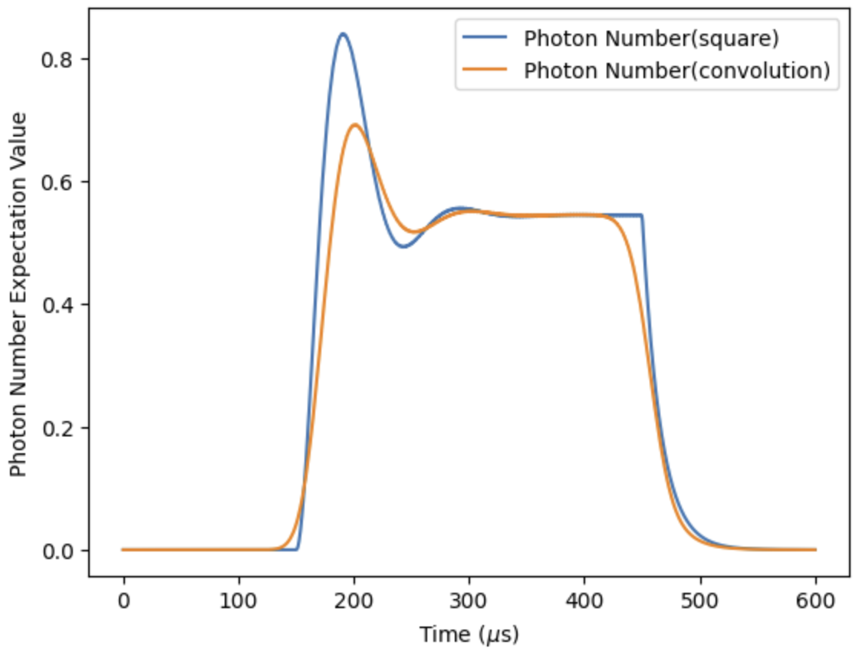
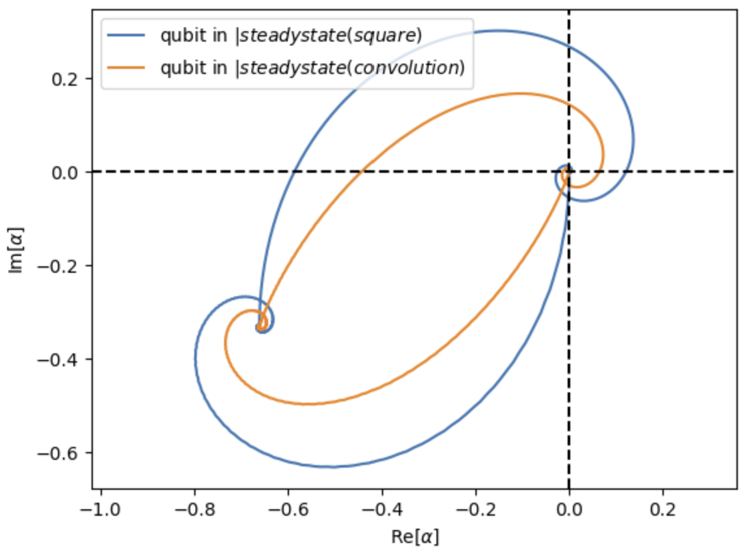
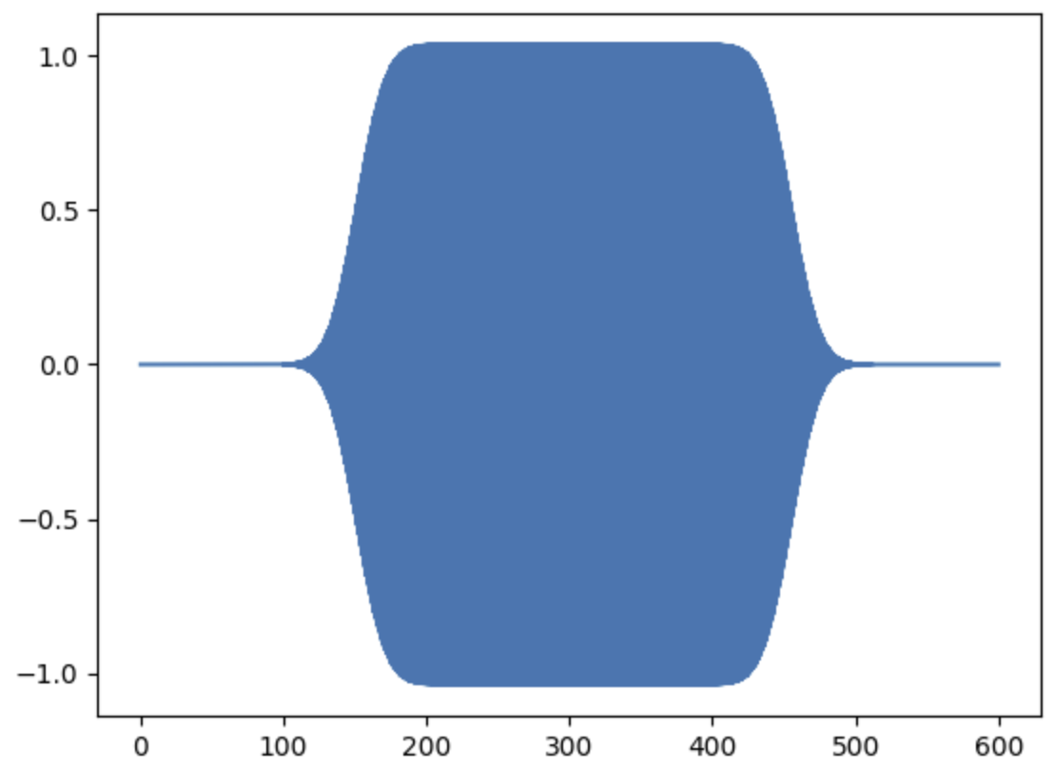
Resonator Drive Pulse
Compare Square Pulse with Convoluted Pulse
Gaussian Pulse Band Width : 1/k
Equal Steady State Photon Number

Slide 13
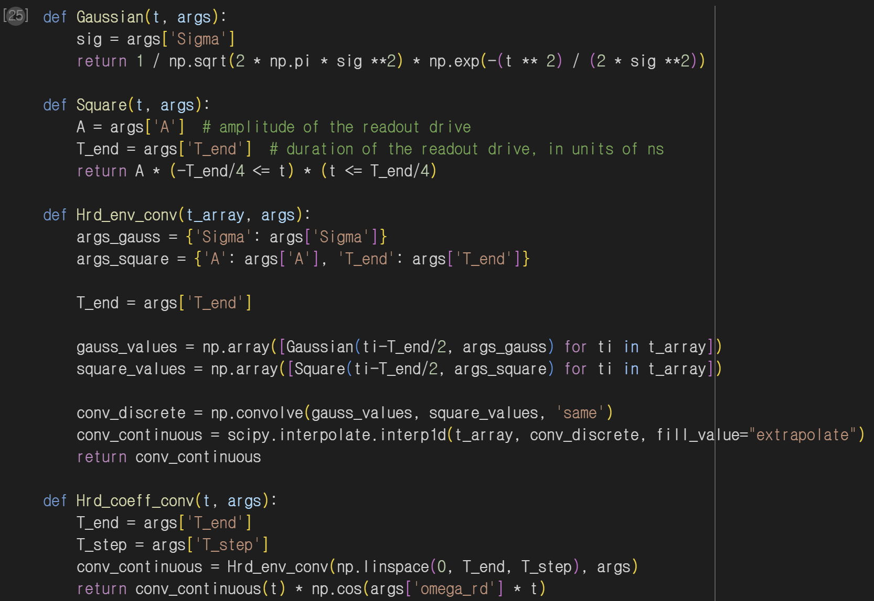
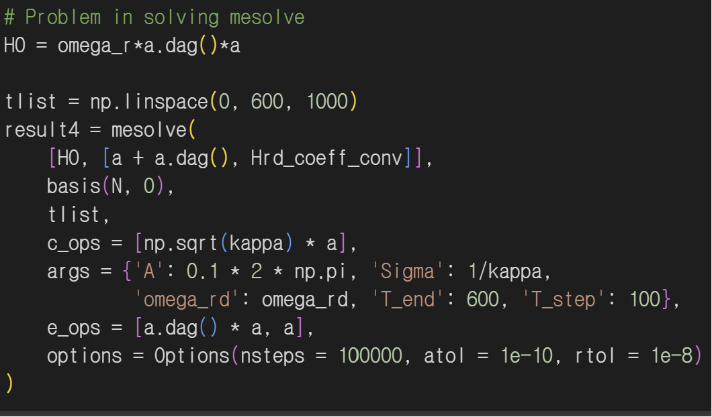
Resonator Drive Pulse
Python Skill (Object Oriented Programming)

Slide 14
TI Qubit Resonator Hamiltonian
(Quantum Rabi)

Slide 15
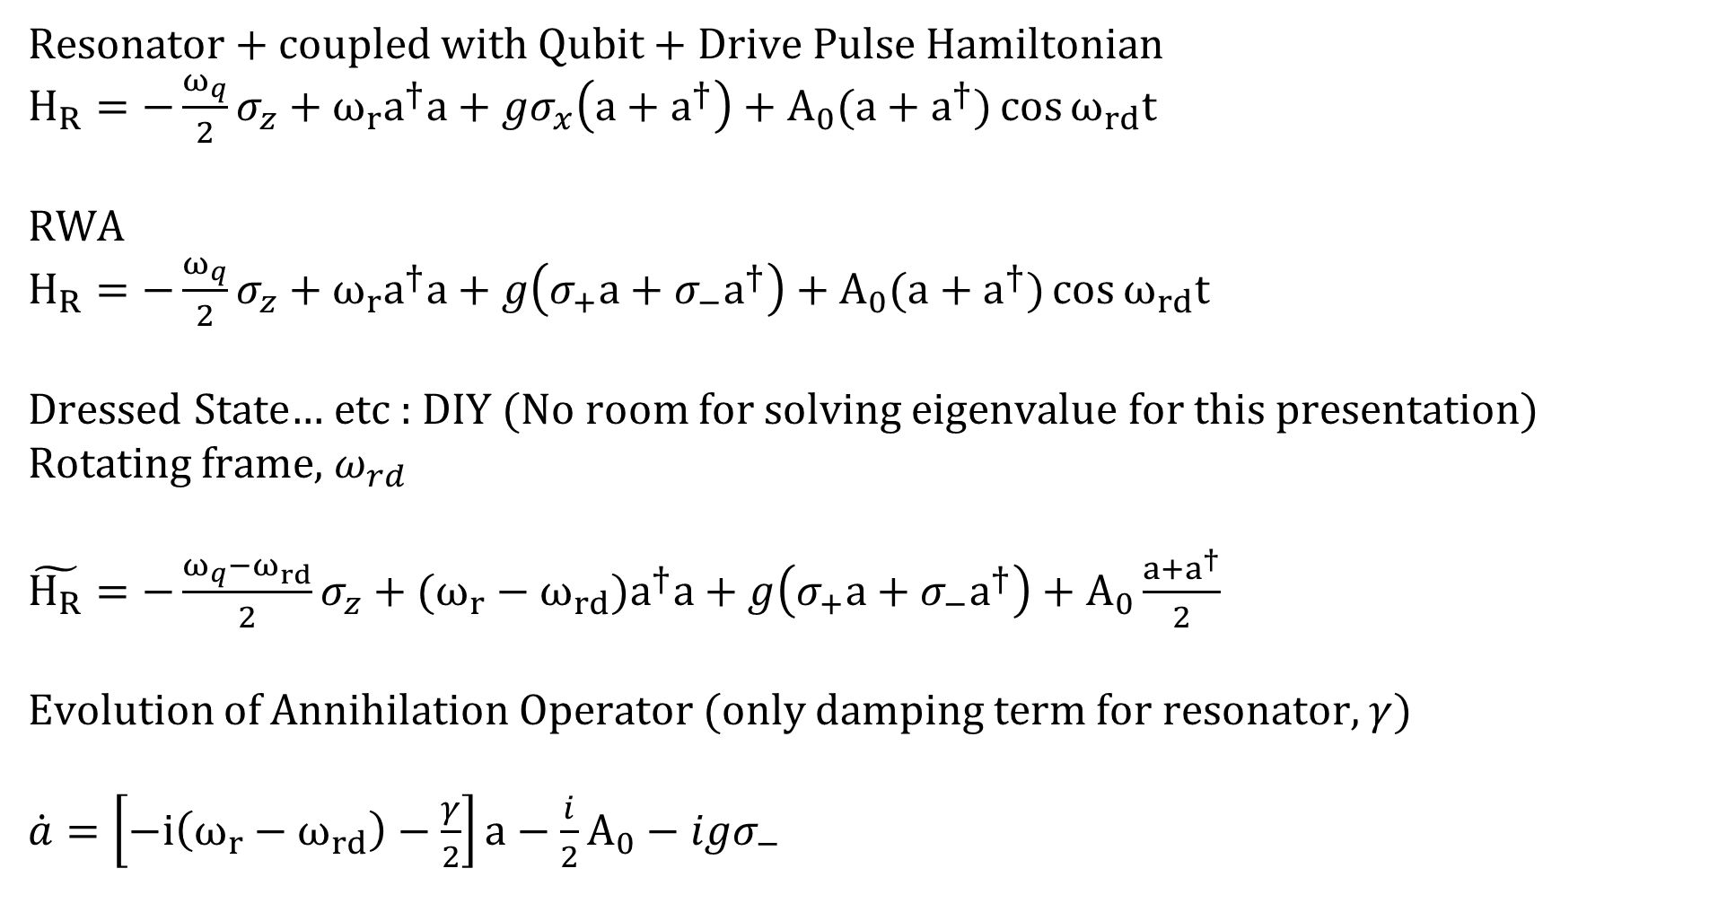
Quantum Rabi
Resonator + coupled with Qubit + Drive Pulse Hamiltonian
$H_{R}=−\frac{ω_{q}}{2}σ_{z}+ω_{r}a^{†}a+gσ_{x}\left(a+a^{†}\right)+A_{0}(a+a^{†})\cos{ω_{rd}t}$
RWA
$H_{R}=−\frac{ω_{q}}{2}σ_{z}+ω_{r}a^{†}a+g\left(σ_{+}a+σ_{−}a^{†}\right)+A_{0}(a+a^{†})\cos{ω_{rd}t}$
Dressed State… etc : DIY (No room for solving eigenvalue for this presentation)
Rotating frame, $ω_{rd}$
$\tilde{H_{R}}=−\frac{ω_{q}−ω_{rd}}{2}σ_{z}+(ω_{r}−ω_{rd})a^{†}a+g\left(σ_{+}a+σ_{−}a^{†}\right)+A_{0}\frac{a+a^{†}}{2}$
Evolution of Annihilation Operator (only damping term for resonator, $γ$)
$\dot{a}=\left[−i\left(ω_{r}−ω_{rd}\right)−\frac{γ}{2}\right]a−\frac{i}{2}A_{0}−igσ_{−}$

Slide 16
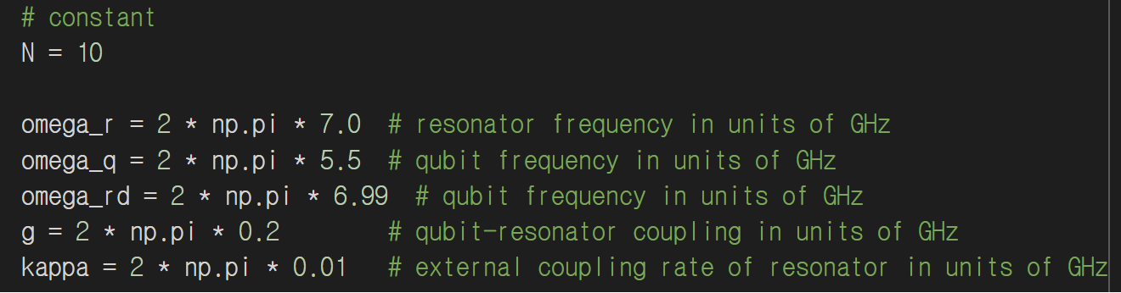

Quantum Rabi
Evolution of Operators
$\dot{a}=\left[−i\left(ω_{r}−ω_{rd}\right)−\frac{γ}{2}\right]a−\frac{i}{2}A_{0}−igσ_{−}$
$\dot{a^{+}}=\left[i\left(ω_{r}−ω_{rd}\right)−\frac{γ}{2}\right]a^{+}+\frac{i}{2}A_{0}+igσ_{+}$
$\dot{σ_{−}}=\left[−i\left(ω_{q}−ω_{rd}\right)−\frac{γ}{2}\right]σ_{−}−igσ_{z}a$
$\dot{σ_{+}}=\left[i\left(ω_{q}−ω_{rd}\right)−\frac{γ}{2}\right]σ_{+}+igσ_{z}a^{+}$
$\dot{σ_{z}}=−2igσ_{−}a^{+}+2igσ_{+}a$

Slide 17
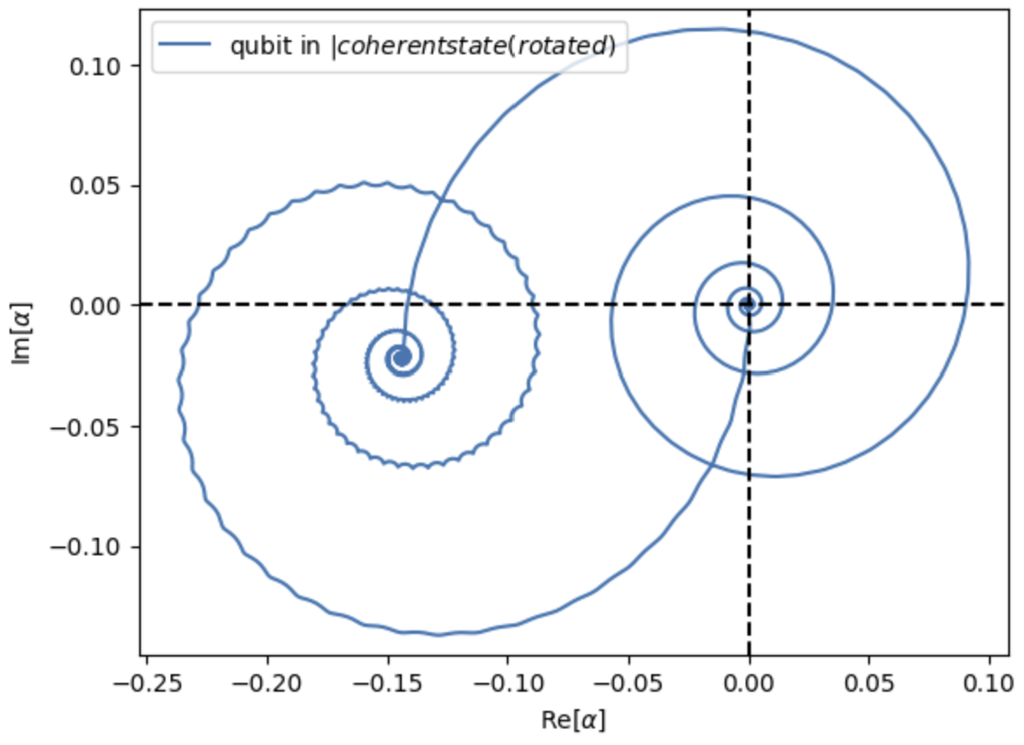
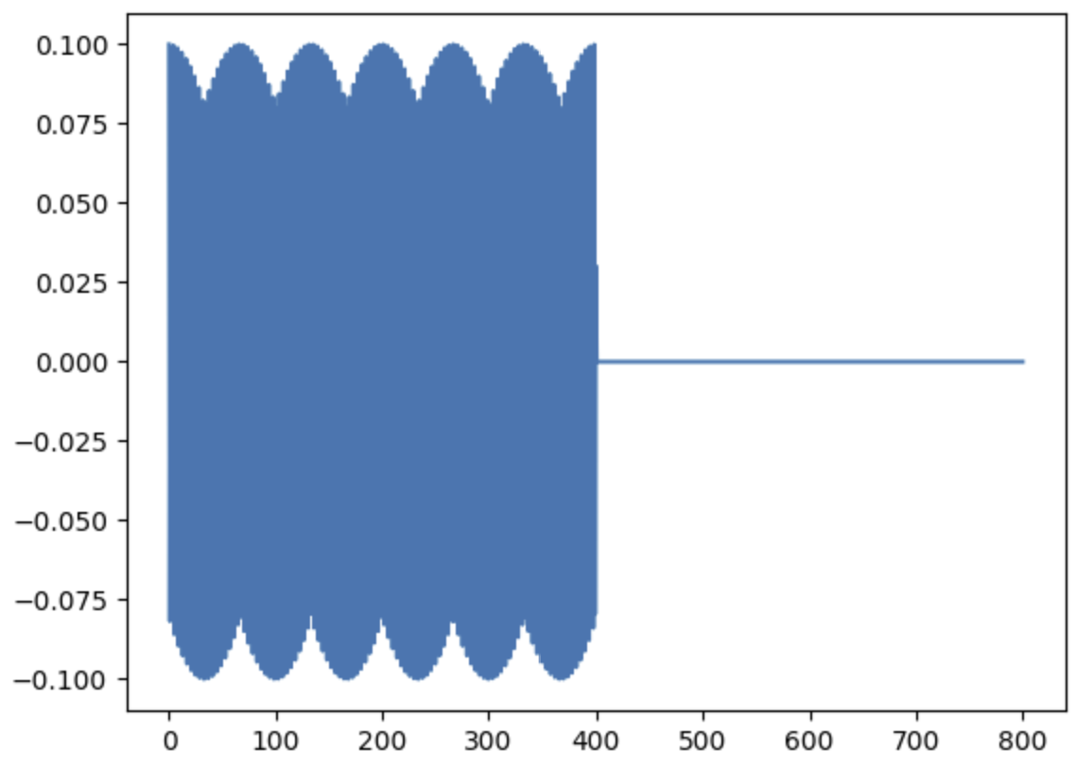
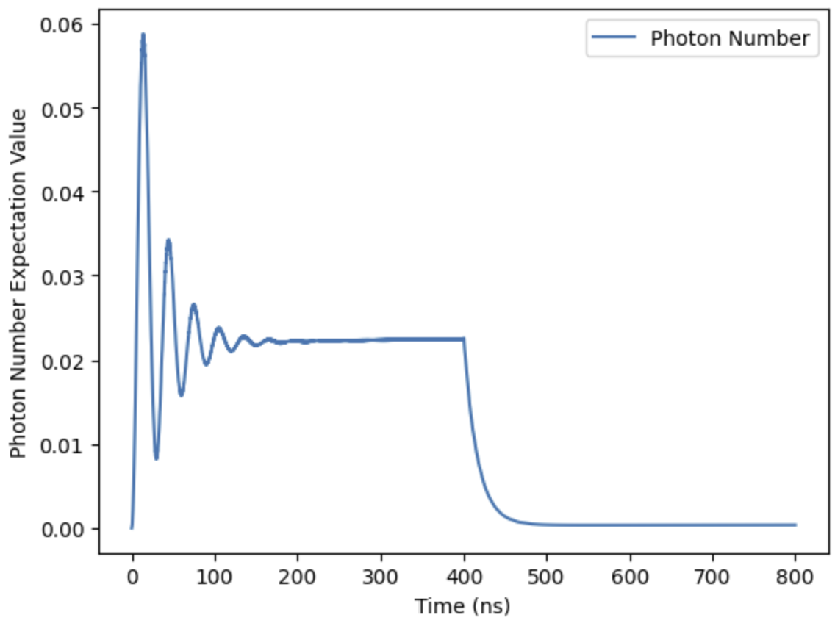
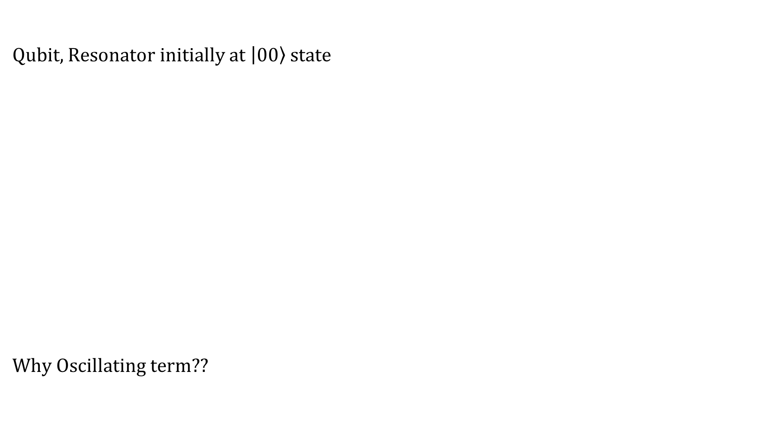
Quantum Rabi
Qubit, Resonator initially at $\left|0\right.\left.0\right\rangle$ state
Why Oscillating term??

Slide 18
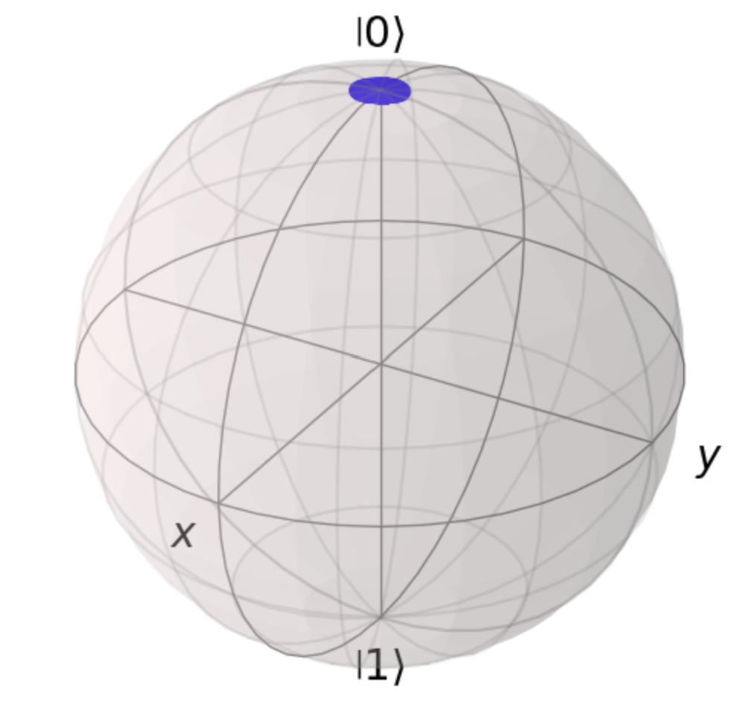
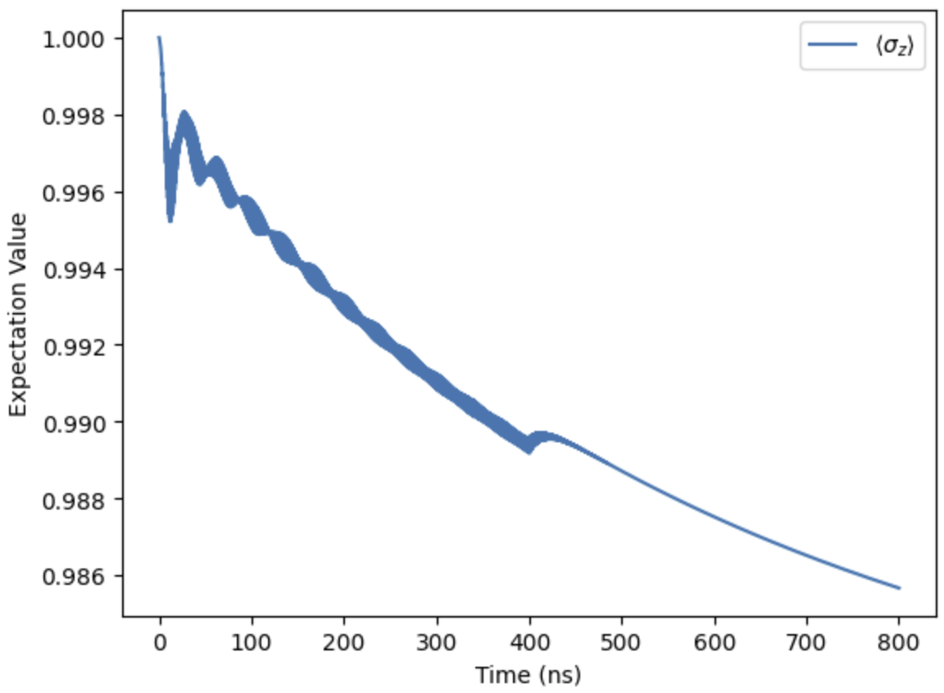
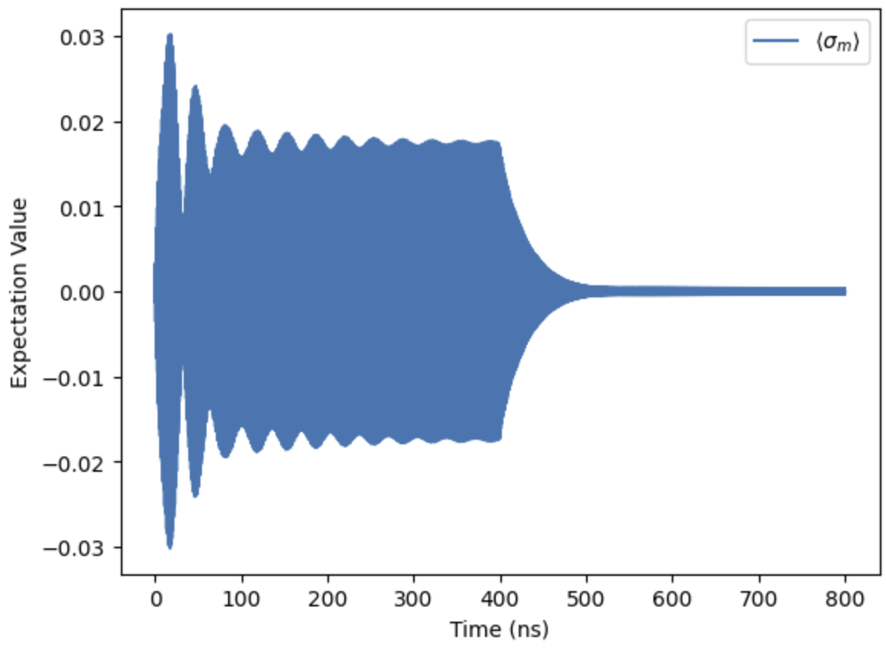
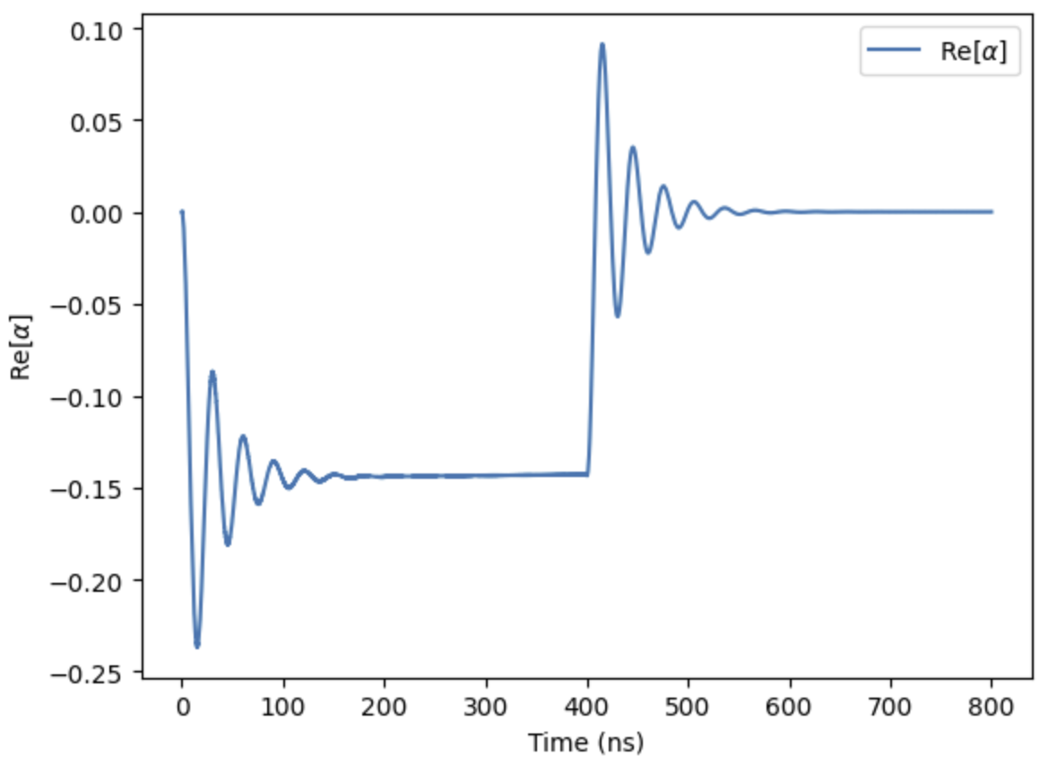
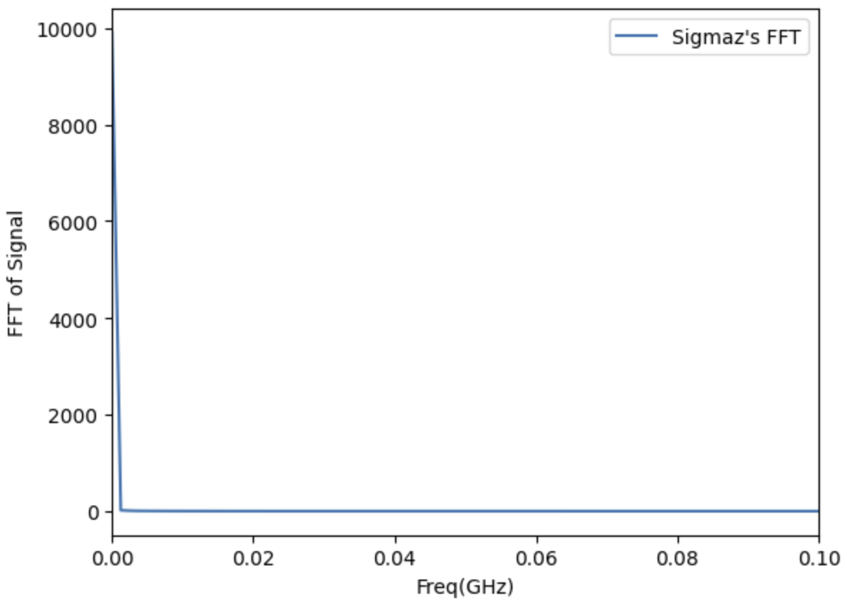
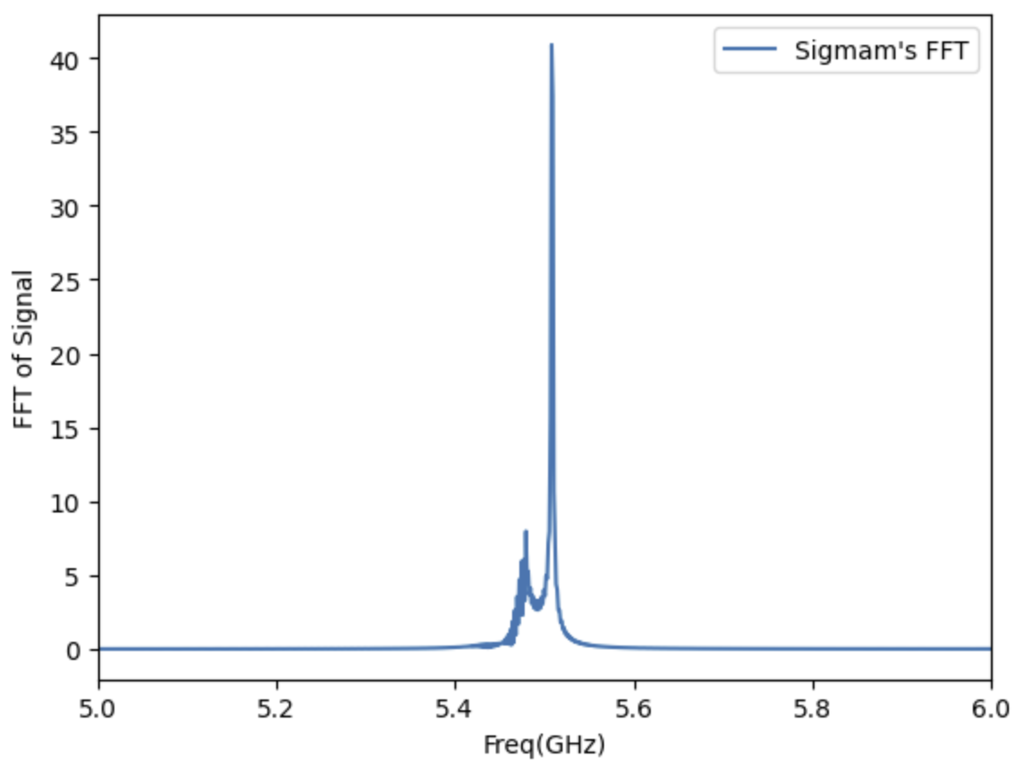
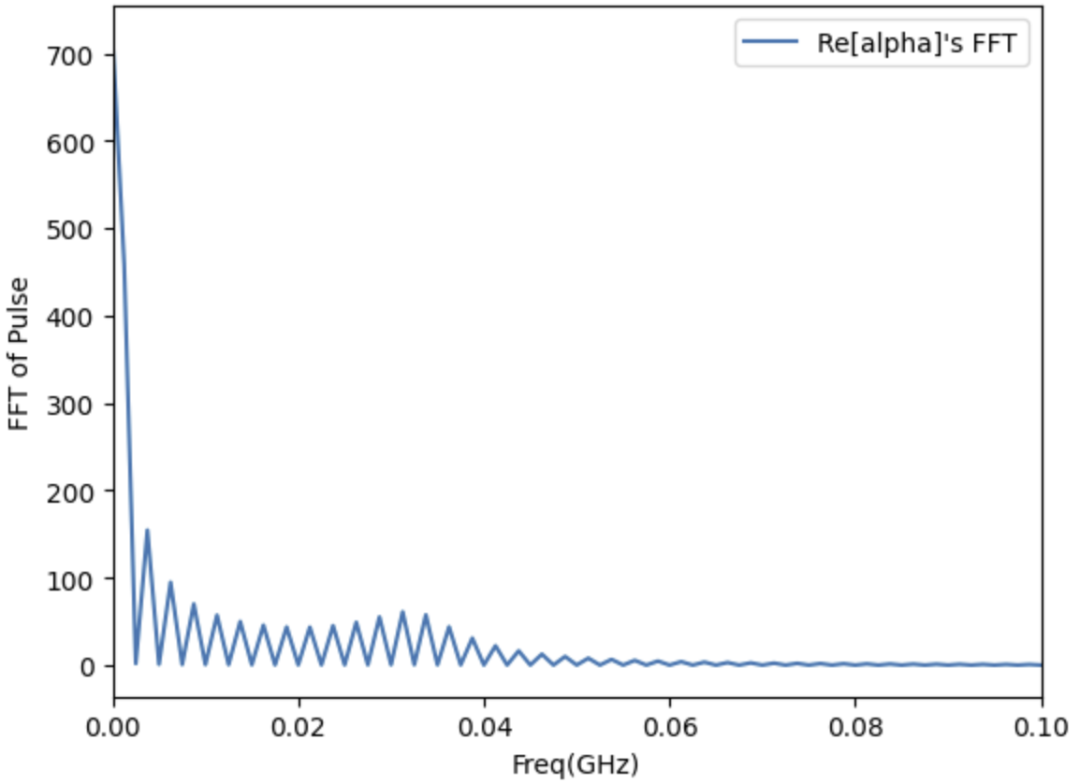
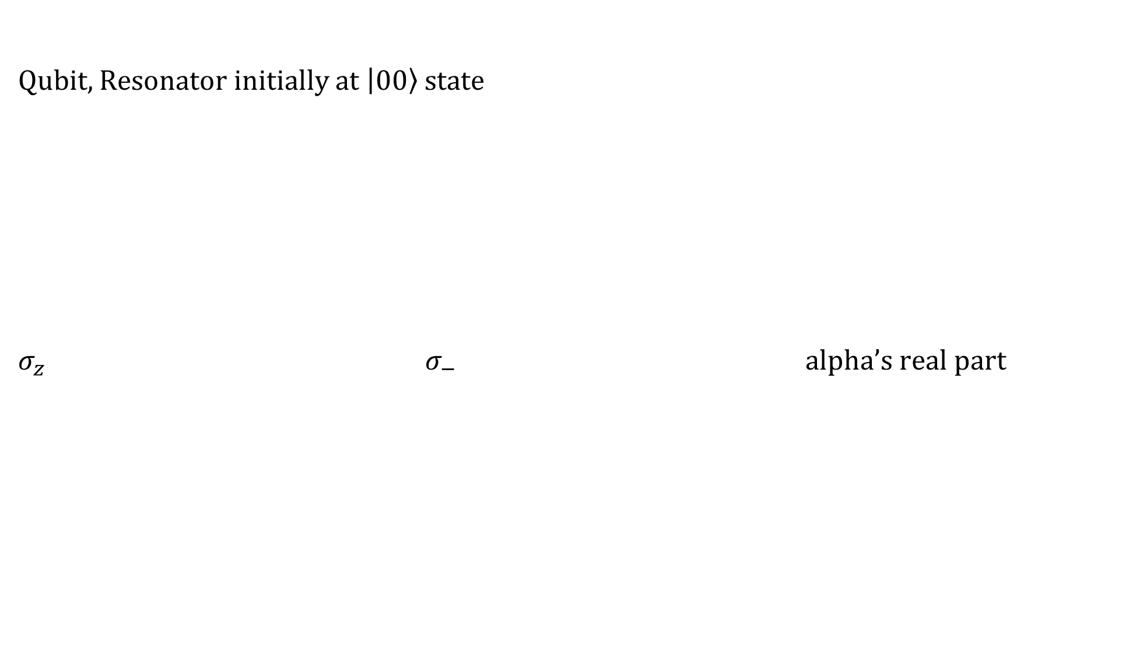
Quantum Rabi
Qubit, Resonator initially at $\left|0\right.\left.0\right\rangle$ state
$σ_{z}$ $σ_{−}$ alpha’s real part

Slide 19
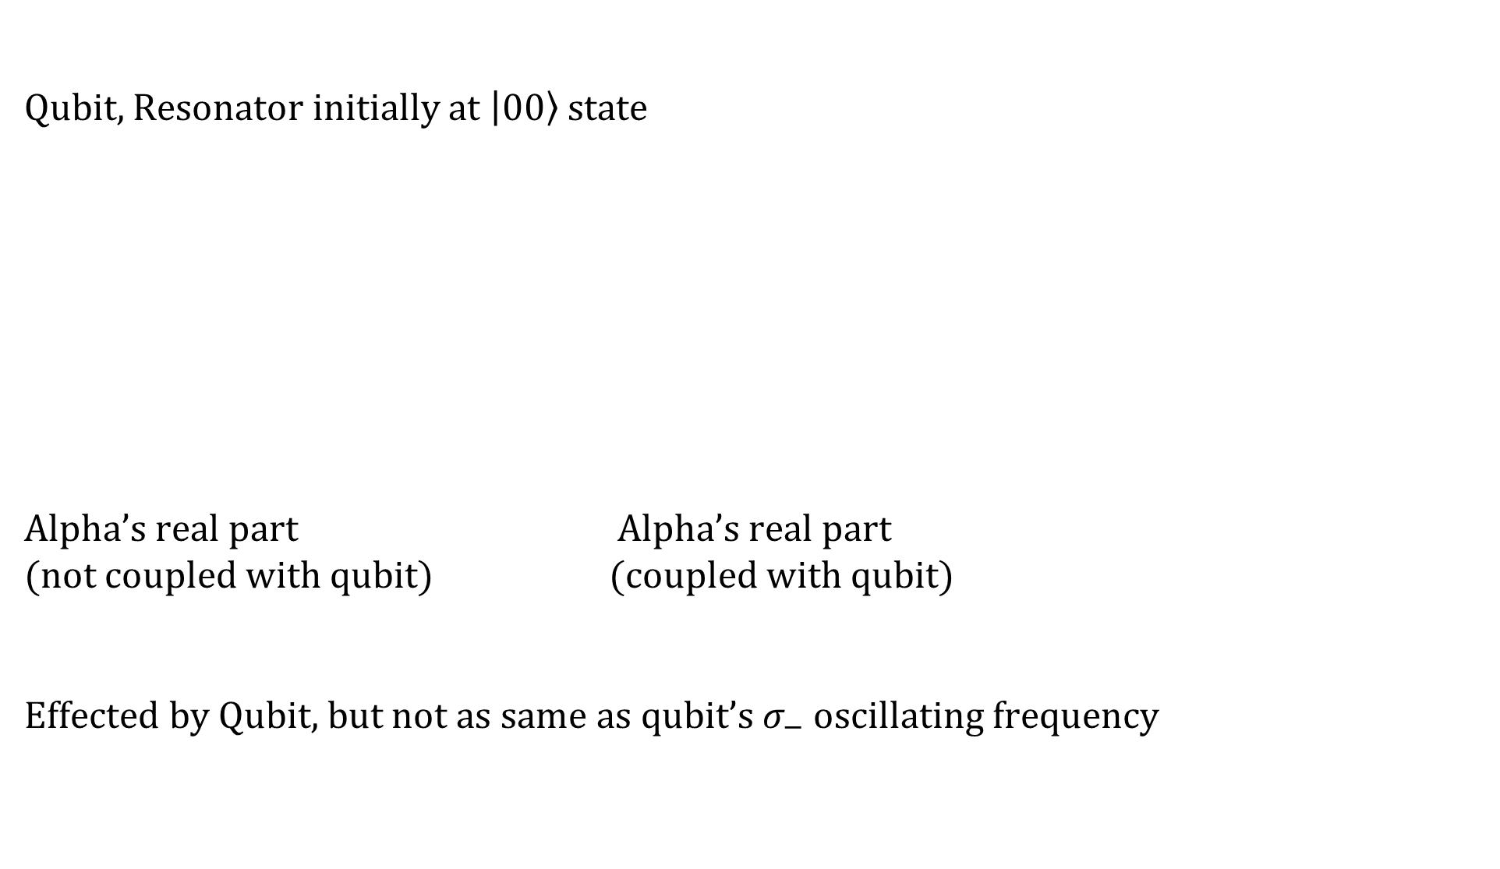
Quantum Rabi
Qubit, Resonator initially at $\left|0\right.\left.0\right\rangle$ state
Alpha’s real part Alpha’s real part
(not coupled with qubit) (coupled with qubit)
Effected by Qubit, but not as same as qubit’s $σ_{−}$ oscillating frequency

Slide 20
Quantum Rabi
More Information @ my github!!!
https://github.com/BrainConnection/QuTiP
https://github.com/BrainConnection/Qiskit

Slide 21
Thank you

